Slide 1
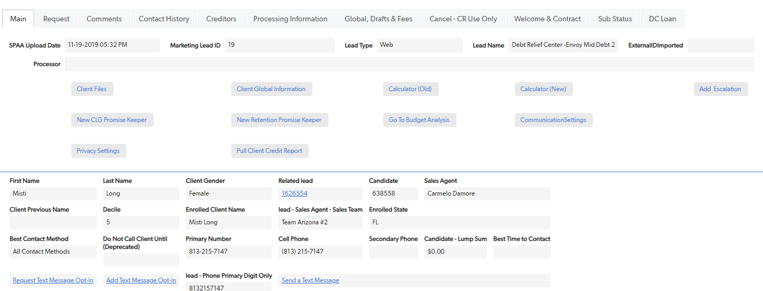
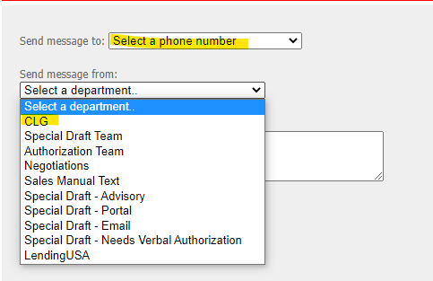
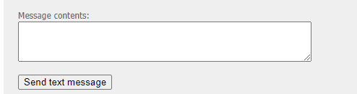
How send a Text Message
1
2
4
3
5
Notes:
Sending a text message is easy. Go to the client QuickBase Page and click the “send a text message” link.
From there you can choose the phone number you are sending to and either create your own message or copy and paste the one from the guide
If a client you are working with requests a follow up at a certain time, OR if you need to contact a creditor at a certain time, you can set a Promise Keeper (PK) for yourself. That PK will pop up on your screen at the time that you put it in (once you are available).

